Slide 1
Chapter 34 NP-Complete--Overview
Overview of NP-Complete theory (NPC)
  Polynomial vs exponential (superpolynomial)
  Decision problems vs optimization problems
  Reduction
  Verification
  3 classes of problems: P, NP and NPC
  The NPC theory
  The first NPC problem
Formal description
How to show a problem is in NPC

Slide 2
Polynomial vs Exponential
n | 10 | 30 | 50 | 70 | 90 | 110 | 130
CPU time
CPU time
Assume multiplies per second
Problems without existing polynomial algorithm: intractable

Slide 3
Some problems
Sorting
  Time complexity
  Lower bound?
  Polynomial algorithm exists?
0-1 knapsack problem
  Time complexity
    Pseudo polynomial
  Lower bound?
  Polynomial algorithm exists?

Slide 4
Decision problems vs optimization problems
Optimization problem: the answer is an optimal solution
  0-1 knapsack problem
Decision problem: the answer is “yes” or “no”
  0-1 solution of a linear equation
Optimization problems can be converted to decision problems
  Example 0-1 knapsack problem
    Optimization version
    Decision version: given (v, w, W), is there a selection of the items such that the total value is at least k?
    Algorithm A(v, w, W, k) = 1 if there is.

Slide 5
Relation of optimization and decision problems
Decision problem can be solved in polynomial time => corresponding optimization problem can be solved in polynomial time
NPC theory is based on decision problem and formal language.

Slide 6
Decision vs optimization: con’t
How to find optimal solution & value using A(v, w, W, k):
  basic idea: the maximum value is
  use binary search to find exact optimal solution and value.

Slide 7
Reductions
Instance: an input to a particular problem
  Example (knapsack):
  #possible instances:
For 2 problems A & B, suppose a procedure that transforms any instance of A into some instance of B such that
  The answers are the same, i.e., answer for is ‘yes” iff the answer for is also “yes”
The above procedure is called reduction
  If reduction is in polynomial time, then called polynomial reduction

Slide 8
Example

Slide 9

Reductions con’t
Suppose
Claim: If exists polynomial time algorithm solving B =>
exists polynomial time algorithm solving A
Informal proof:
  Transform alpha in A to beta in B
  Solve B for instance beta
  Use the answer for beta as the answer for alpha
Example:

Slide 10
Verification algorithms
Example-- Hamiltonian cycle problem:
  Hamiltonian cycle: a simple cycle where each vertex appears exactly once (a permutation of vertices)
  given graph G=(V, E) and a permutation of vertices, can we verify if the permutation is a Hamiltonian cycle in polynomial time?
  A verification algorithm verifies if the given permutation is Hamiltonian cycle.
Verification algorithm A:
  2 arguments x & y
    x an instance (a graph G)
    y: certificate (a permutation of vertices)
  A verifies x if there exists a certificate y such that A(x,y)=1

Slide 11
3 classes of problems
P={problems whose solution can be found in polynomial time}
  e.g.: sorting, optimal BST, matrix multiply
NP={problems whose solution can be verified in polynomial time}
  ={problems that have non-deterministic polynomial time algorithms}
  e.g.: 0-1 knapsack, linear programming, sorting
NP-Complete (NPC) ={ problems Q in NP such that all other problems in NP can be reduced in polynomial time to Q}
  Longest path, Hamiltonian cycle, UPS delivery

Slide 12
NPC and NPC Theory--informal
NPC: a set of problems in NP:
  as hard as any problems in NP
  no polynomial time algorithms have been discovered
  no proof that polynomial time algorithms do not exist.
NPC theory;
  Polynomial time algorithms exist for one NPC problem=>
    all problems in NP have polynomial algorithms & NP=P,
  Polynomial time algorithms do not exist for one NPC problem=>
    all problems in NPC do not have polynomial time algorithms & NP!=P
NP=P? open since 1971.
Question: given problem Q in NP, no polynomial algorithm yet, how to know Q is in NPC or not?

Slide 13

A theorem
Let Q be in NP. If D NPC, and D can be reduced in to Q, then Q NPC
Proof:

Slide 14
Showing problem Q to be NPC—2 steps
Need to show Q is in NP
Need to show a NPC problem can be reduced to Q polynomially
Example: Let 0-1SoLE NPC. Show 0-1SoLEH NPC
How about the first NPC problem

Slide 15
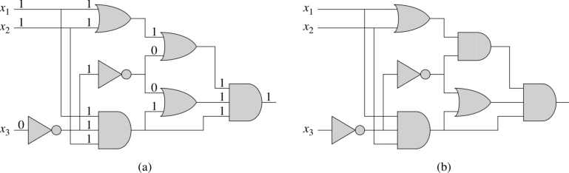
The first NPC problem
Circuit-satisfiability problem: given a Boolean expression
f=(x1, x2, …, xn, AND, OR, NOT, “(“, “)”)
  in terms of n variables with
  logic operators AND, OR, NOT and parentheses
Is there an input combination such that f = 1?
Proved by Dr. Cook in 1971

Slide 16
A Formal Language Framework
Alphabet : a finite set of symbols
Language L over : any set of strings made up of symbols in
Example:
  : 26 letters; L1 : English; L2: Spanish
  ={0, 1};

Slide 17
Alphabet = {0, 1}
Empty string
Empty language
*: set of all binary strings
  Every language L over is a sub set of
Set operations
  Union
  Intersection
  Complement
  Concatenation

Slide 18



Lemma 34.3
Let Q1 & Q2 be 2 decision problems such that
then implies

Slide 19
NP- complete, NP-hard & Theorem 34.4
Definition: A decision problem Q is NP-complete if
  Q NP and
  Q’ Q for every Q’ NP.
Definition: A decision problem Q is NP-hard if
  Q’ Q for every Q’ NP
Theorem 34.4
  If any NP-complete problem is polynomial time solvable, then P=NP.
  Equivalently, if any problem in NP is not polynomial time solvable, then no NP-complete problem is polynomial time solvable.

Slide 20
NP-complete (NPC) Proofs
Lemma 34.8:
  If Q is a decision problem such that Q’ Q for some Q’ NPC, then Q is NP-hard.
  Moreover, if Q NP, Q NPC
By reducing a known NPC problem Q’ to Q, we implicitly reduce every problem in NP to Q.
Steps for proving a NPC problem Q
  Prove Q NP by verifying
  Select a known NPC problem Q’
  Construct a reduction function f mapping every instance x Q’ to an instance f(x) Q.
  Prove f satisfies x Q’ iff f(x) Q
  Prove the algorithm computing f is polynomial time.

Slide 21
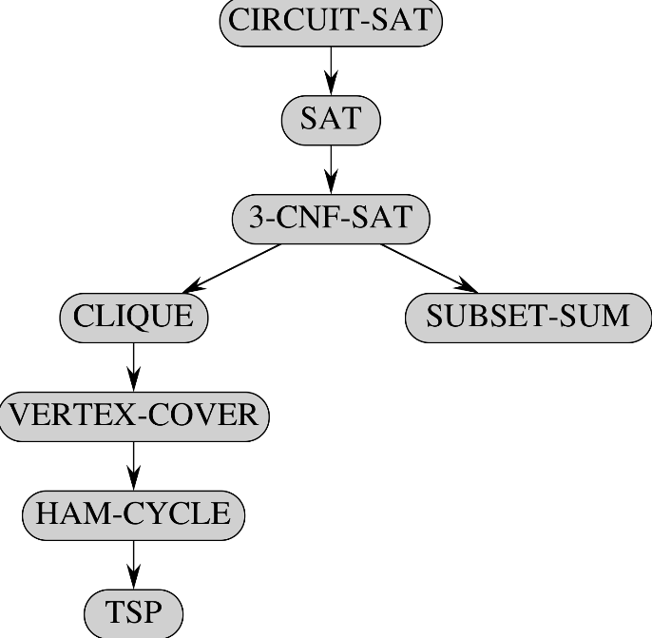
Structure of NPC proofs (Fig 34.13)
Circuit-SAT & SAT proved by Cook.
UPS delivery

Slide 22
Circuit satisfiability
Given a Boolean combinational circuit composed of AND, OR and NOT gates, is it satisfiable?
Example:
CIRCUIT-SAT ={Satisfiable Boolean combinational circuits}
Theorem: CRICUIT-SAT is NPC
Basic idea of the proof

Slide 23




Formula satisfiability problem: Formula SAT
A Boolean formula is composed of
  n Boolean variables x1, x2, …, xn
  m Boolean connectives: AND OR NOT
  parentheses
Literal: an occurrence of x or
Problem size
Truth table of the connectives

Slide 24
Formula SAT, con’t
A satisfiable formula : there exists an input combination such that =1
SAT decision problem: given a Boolean formula , is there an input combination such that =1?
SAT={ : is satisfiable}

Slide 25

Theorem 34.9: SAT NPC ---Proof
SAT NP
Construct the reduction algorithm:

Slide 26

3-CNF satisfiability
Conjunctive normal form (CNF) of Boolean formula:
  Literal: either x or for some variable x.
  A Boolean formula is in CNF if it is the product of sums of literals
  Example
3-CNF: each product has exact 3 distinct literals.
  Example:

Slide 27
Theorem 34.10: 3-CNF SAT NPC--Proof
3-CNF NP
Construct a reduction algorithm
  input: any formula in terms of
  output: 3-CNF formula
  step 1: convert to conjunction of clauses
  Step 2: convert each clause to CNF
  step 3: convert CNF to 3-CNF

Slide 28
Summary
Decision vs optimization
Reduction
Verification
3 classes of problems: P, NP and NPC
The NPC theory
How to show a problem is in NPC

